Slide 1
THE GOLDILOCKS PRINCIPLE: READING CHILDREN’S
BOOKS WITH EXPLICIT MEMORY REPRESENTATIONS
- author Felix Hill
Yi ZHOU

Slide 2
Main contributions of this paper
Set up a new corpus - Children Book Test
Applying Memory network model into Machine reading comprehension

Slide 3
Look details of the corpus
Features
Randomly selecting 10 nouns or Named entities from paragraph.
The first 20 sentences are considered as document.
There 10 answer candidates are in same category.
Named Entity
Nouns
Verbs
Preposition

Slide 4
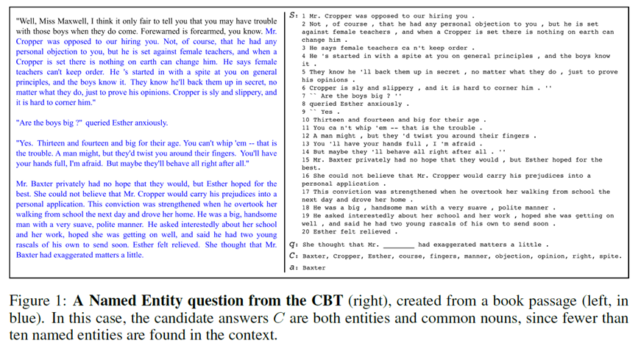

Slide 5
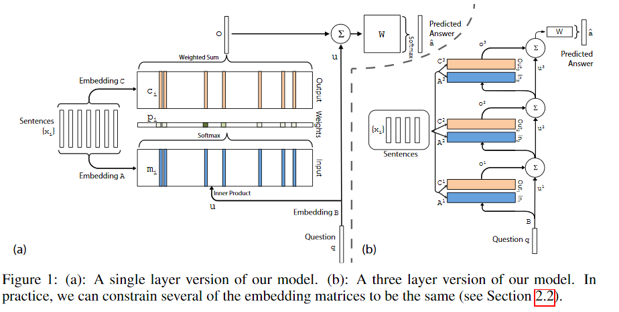
Memory network
Model structure graph
cited “End-To-End Memory Networks” Sainbayar Sukhbaatar, et.

Slide 6
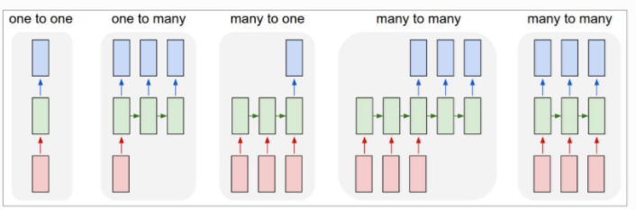
End to End Memory Networks
Seq2seq neural network model
Reading materials
Word, sentence, paragraph, document embedding
Recurrent neural network architecture
Notes:
The aim is to display my programming ability

Slide 7
My current idea
Study statistical Natural language processing & Neural network
Focus on Machine reading comprehension
Reasons
Having prior knowledge on “probability”, “linear algebra”, “calculus”, I can learning more about word vector, statistical NLP
As Elizebthe masters linguistics, using syntactic and semantic parsing, then we can combine these two methods to implement higher accuracy in the future
My background is software engineering and have strong programming skill.

Slide 8
Share
All related materials are in github repository
https://github.com/yipersevere/masterProjectInUTA

